Slide 1
('-. .-') _ ('-. .-. ( OO ).-. ( OO) ) ( OO ) / / . --. / ,--. ,--. / '._ ,--. ,--. | \-. \ | | | | |'--...__)| | | | .-'-' | | | | | .-')'--. .--'| .| | \| |_.' | | |_|( OO ) | | | | | .-. | | | | `-' / | | | .-. | | | | |(' '-'(_.-' | | | | | | `--' `--' `-----' `--' `--' `--' .-') .-') ('-. .-') ( OO ). ( OO ). _( OO) ( OO ). ,-.-') (_)---\_)(_)---\_) ,--. ,--. (,------.(_)---\_) | |OO)/ _ | / _ | | | | | | .---'/ _ | | | \\ :` `. \ :` `. | | | .-') | | \ :` `. | |(_/ '..`''.) '..`''.) | |_|( OO )(| '--. '..`''.) ,| |_.'.-._) \.-._) \ | | | `-' / | .--' .-._) \ (_| | \ /\ /(' '-'(_.-' | `---.\ / `--' `-----' `-----' `-----' `------' `-----'

Slide 2
Authentication Overview
Authentication of users is important for confidentiality
As websites move from simply displaying information to becoming web applications authentication becomes more and more important
Authentication systems utilize a lot of technologies/systems

Slide 3
Authentication Walkthrough
Note: assuming an already registered user
User enters username and password
Username and password are sent to the server
The password is hashed
The database is checked for a user containing that name and password hash that matches the submitted hash
If the username and password match a record then a session cookie is sent back and that acts as a form of authentication for future requests
The login is about issuing a valid session token in the form of a cookie; an ID badge sent with future requests

Slide 4
Can you think of any attacks on this system?

Slide 5
Attacks on Authentication
Session Fixation
Improper Session Invalidation
Timing Attacks
User Enumeration
Timing
Error Messages
Insecure Cookie Settings
Insufficient Entropy

Slide 6
Session Fixation

Slide 7
Session Fixation
An attack that allows an attacker to hijack a valid session
Due to a system that, when authenticating a user, uses an existing session token instead of assign a new session ID
An attacker forces a user to authenticate him/herself with a known session ID
The known session ID then becomes valid and an attacker can use it to do evil things

Slide 8
Session Fixation
Several methods execution
Session token in the URL argument
Attacker tricks victim into clicking on a crafted hyperlink containing the session token
Session token in a hidden form field
A user is tricked into authenticating using a crafted login form hosted by the attacker containing the session token
Session ID in a cookie
An XSS attack can be used to set a cookie value in the victims browser to a known value
Using <meta http-equiv=Set-Cookie content=“sessionid=foo”>
An attacker with a MITM position can send a Set-Cookie header to the victim, setting their cookies
If user generated code can be hosted on the same domain legitimately it can be used to set the session cookie

Slide 9
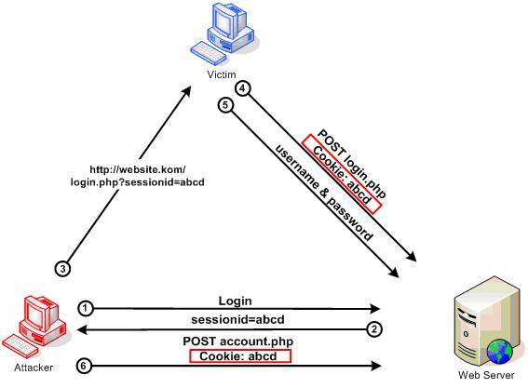

Slide 10
Testing for Session Fixation
Login
Change the session token (keep the same format)
Login again
See if a new token is issued

Slide 11
Fixing Session Fixation
When a user logs in clear old session cookies and always set a new cookie

Slide 12
Improper Session Invalidation

Slide 13
Improper Session Invalidation
When a user logs out the session should be deleted
Sometimes it is only deleted client-side
Using JavaScript or setting the cookie expiration date to sometime in the past
An attacker with a stolen session won’t receive the client-side delete and can keep using the session
Greatly increases the value of a stolen session

Slide 14
Testing for Improper Session Invalidation
Login
Copy the session token
Logout
Put the old session token back
See if you are logged in

Slide 15
Fixing Improper Session Invalidation
Sessions must be deleted server side!!
Clear the session token from the database

Slide 16
Timing Attacks & User Enumeration

Slide 17
Timing Attacks
Operations take time
Comparing two strings
Looking up a user, then their password
String validation checks
The time it takes for an operation to complete leaks information about what is happening under the hood
This can be exploited to find valid users, or even valid passwords

Slide 18
User Enumeration
Timing attack
If the authentication form looks up the user then matches the password hash those two operations occur one after the other
That means that an attacker can potentially watch how long a reply takes and figure out if they have found a valid user
A request with a valid user will take slightly longer to reply because first the user lookup occurs, then the password check

Slide 19
User Enumeration
Error messages
“please enter a valid user”
“the password you entered is incorrect”
“login for the user foobar failed”
These messages can tell you if a user is in the system or not
A valid username can then be used in a brute forcing or spear phishing attack
Can even be used in a fake leak

Slide 20
Testing for User Enumeration
Timing attacks
Try logging in with several usernames (some valid and some invalid) several times
Use invalid passwords
Watch to see if a reply to a valid user takes longer than an invalid user
Error messages
Try logging in with several usernames (some valid and some invalid) several times
Use invalid passwords
See if the error messages change

Slide 21
Fixing User Enumeration
Lookup users in a consistent manner
Use SQL that checks both the username and password in one statement
Pad the response times so they take too long to brute force
Make all error messages consistent
“Sorry the username or password you entered is incorrect.”

Slide 22
Cookie Settings & Entropy

Slide 23
Cookie Settings
Name - the cookie name
Value - the cookie value
Path - the path the cookie applies to
Expiration - when the cookie expires
Don’t set! Otherwise it is written to disk
If expiration or Max-Age aren’t set it will be deleted when the browser closes
HttpOnly - whether the cookie is accessible to JS
Set to True
Secure - whether the cookie is sent encrypted
Set to True if the site uses SSL/TLS

Slide 24
Cookie Entropy
Make sure your session tokens use a cryptographically secure random number generator
If not then they will be predictable and an attacker just has to try a bunch
Make sure you have ~150 bits of entropy
Demo time?
Burp sequencer

